Slide 1
X-Art Company’s new Franchise Analysis
Introduction/Business Problem :
X-ART company is one of the major chain of stores in India who specializes in selling art/craft items. They also sell antique items and replicas of historical artifacts.
The company has their franchises all over India and all of them have been really successful. Now the company wants to expand their business and decided to venture in to the customer base in USA.
Since this is their first attempt in entering US market, they want to explore all the options and make sure that this is really successful. But the problem is either the marketing team or the Analyst team are not aware of the US customer base.
So they decided to engage ABC consulting firm (in the US who specializes in Business consulting and Data Analytics field.

Slide 2
Introduction/Business Problem - continue
The X-Art company shared all the details about their stores and their budget constrains. The expectation from the ABC analysts is to recommend them where they can open their first store to make sure they have best shot at being successful
MyselF from ABC decided to go with top down approach. So first I had to chose the city for their first store. There were many potential cities which were involved in my analysis.
Since their products are mainly arts and antique artifacts, opening the store in places the cities with museums as the people who visit museums are most likely to be interested in X-ART company’s products.

Slide 3
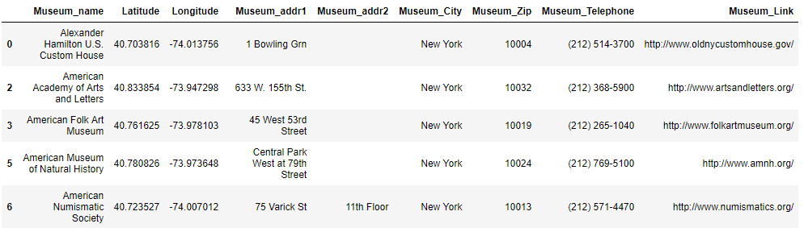
Data :
The main contenders were Chicago, New York, Washington DC etc. The first city I choose for my analysis was New York. This was an obvious choice as there are more number of museums in New York than any other cities in USA.
I downloaded the New York Museums data from Wikipedia. Below is a snapshot of the data.

Slide 4
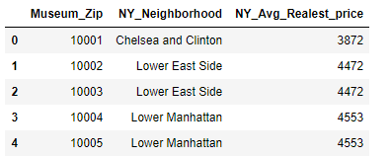
Data - continued
This data contains list of all NY city museums and corresponding address, telephone and URL. The data also contains latitude and longitude information for each museum. This will help me in getting the nearby venues using Foursquare API.
I also downloaded the real estate price($)/square feet for each zip code/neighborhood within New York city limits. Since my client X-ART company has budget constrains as well, this will help me to identify affordable place to rent for their store. Below is a snapshot of the data.

Slide 5
Data - continued
The real estate price for each zip code can be merged with the museum data along with the nearby venues collected by calling Foursquare API. I can implement clustering algorithm on this combined data. The clusters created can be analyzed further to identify top spots/neighborhood for opening the X-ART company store.

Slide 6
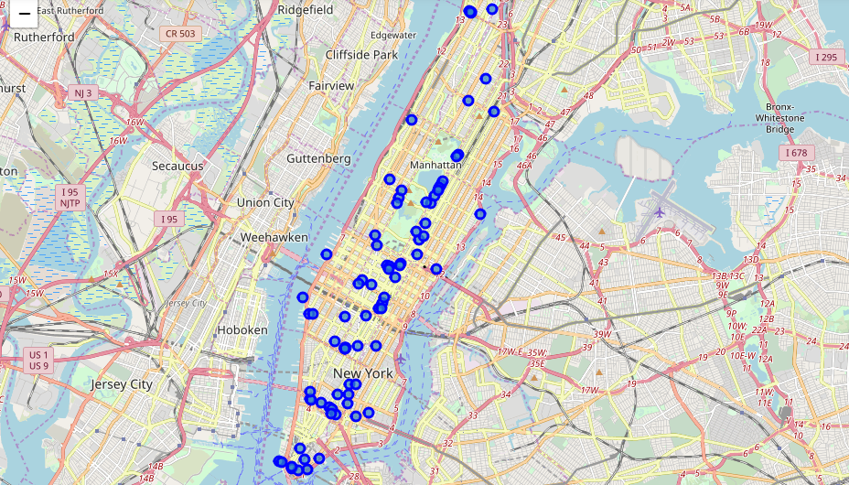
Methodology:
Since my analysis revolves around the Museums in New York, I need to find out where the museums are located in New York. Using the folium map, we can see that most of the museums are located in Manhattan and lower Manhattan

Slide 7
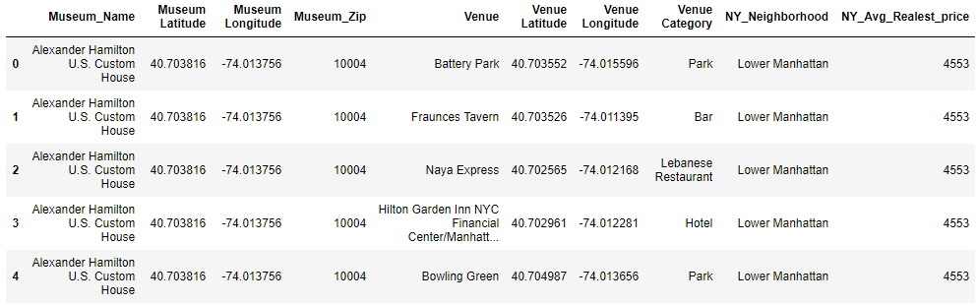
Methodology - continued
I have narrowed down my analysis to the Manhattan area. So I used Foursquare API to get the venues nearby each museum. Later I have merged the real estate price around each museum. Below is a snapshot of the data
As per the data there are around 303 unique venue categories. Since they are categorical values, I need to encode them before using the data in machine learning algorithm. I can also take the mean frequency of each venue category which helps me to know their importance.

Slide 8
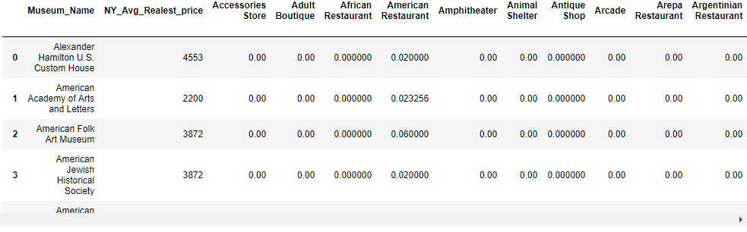
Methodology - continued
Below is the data with venue frequencies
Since there are lot of venues near each museum, I have to select top 10 venues which gives me a fair idea about the kind of venues around each museum. I can also include the real estate price around each museum neighborhood. To identify the top spot for opening the new store I need to first understand the area and venues around each museum. K-means clustering helps me to identify this relationship and group the museums in to different clusters

Slide 9
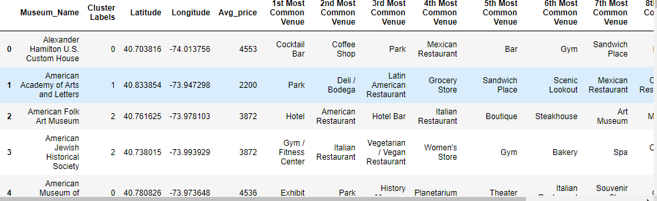
Methodology - continued
I have decided to create 5 clusters and merge the clusters to the original museum data so that I can plot them on Manhattan map and check how the clusters are formed. Below is the data and the map of Manhattan with clusters.
Though the average real estate price was included in creating the clusters, I have included it again so that it is easy for me to analyze the clusters

Slide 10
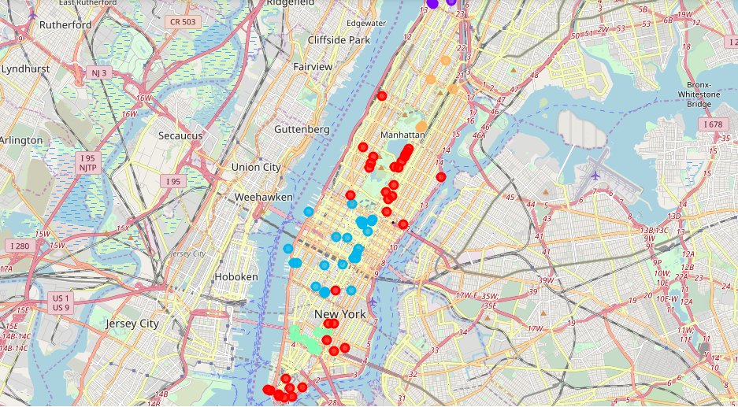
Results:
I have run the data through K-means clustering and plotted each cluster on the map.
Cluster 1 – red, Cluster 2 – purple, Cluster 3 – blue, Cluster 4 – cyan, Cluster 5 – orange

Slide 11
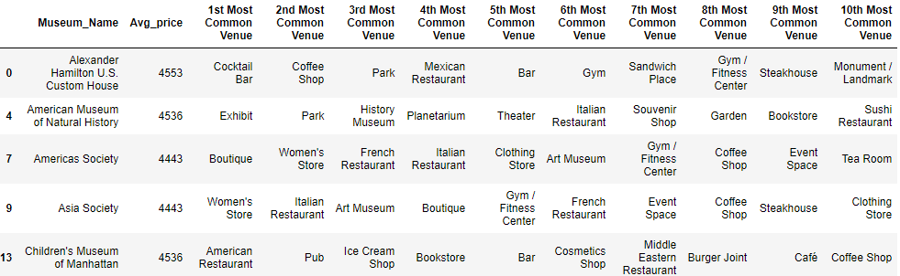
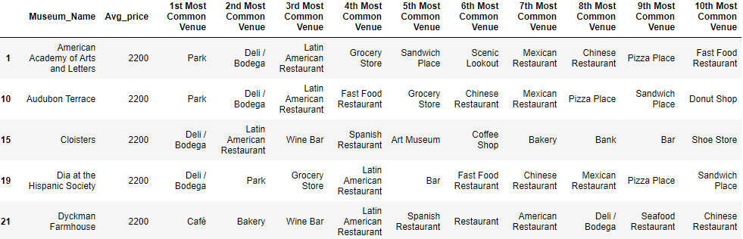
Results- continued
Below are the cluster data with top venues and average real estate price.
Cluster 1
Cluster 2
CLUSTER 2

Slide 12
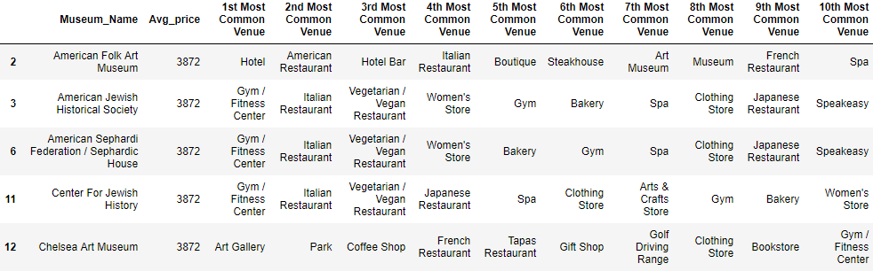
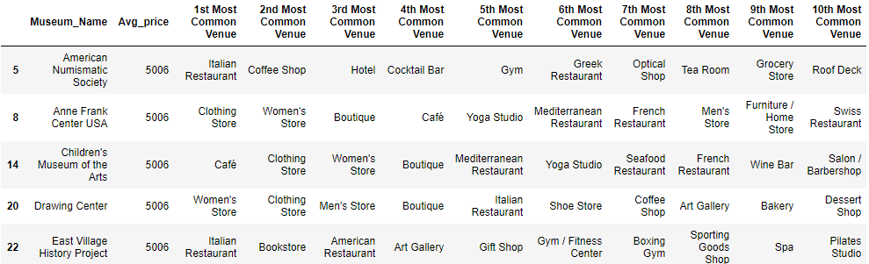
Results- continued
Cluster 3
Cluster 4

Slide 13
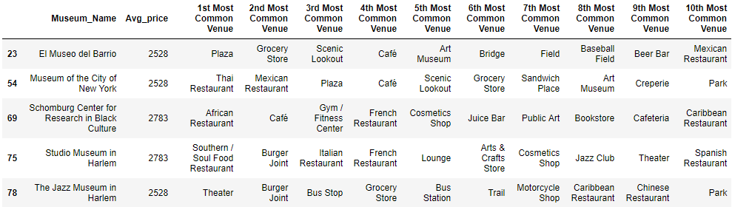
Results- continued
Cluster 5
As per the map with clusters, the cluster 3 is concentrated around mid-Manhattan. Cluster 1 is concentrated around Central park and lower Manhattan. Cluster 4 is mostly near lower Manhattan. Cluster 2 and 5 are mostly upper Manhattan and beyond.

Slide 14
Discussion
Looking at the result, the first thing I wanted to do was to start eliminating any clusters that doesn’t need much attention.
As we can see in the results, though the real estate price is comparatively low around cluster 2 and 5, they are quite far away from main Manhattan area. Also there are very few museums in those neighborhood. So I decided to remove cluster 2 and 5 from further analysis
Now out of Cluster 1, 3 and 4, if I check the real estate price at cluster 1 ($4000+) and cluster 4 ($5000+) are pretty higher than the neighborhood in cluster 3
Since the X-ART has some budget constraint it makes sense to open store in neighborhood around some museums in cluster 3. But cluster 3 stretches from Central park to near lower Manhattan. So need to find a perfect spot to open the new store

Slide 15

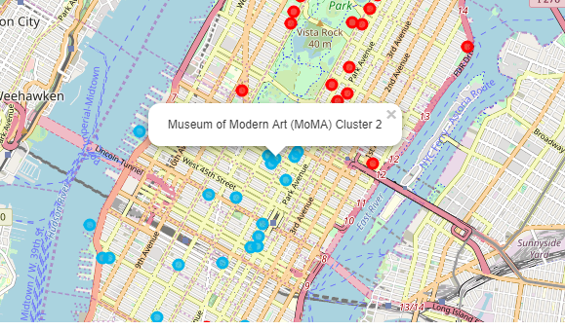
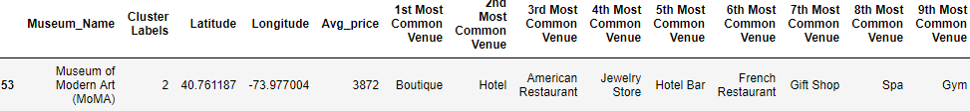
Conclusion:
After looking closely at the museums in cluster 3, I could finalize the sport near Museum of Modern Art (MoMA). There are more than 5-6 other Art museums around this place. And looking at the top 10 venues around this museum, it looks like an ideal spot as it has hotels, restaurants and Bars. I would also recommend X-ART to include toys along with art/historical artifacts as it is close to central park and can attract children as well as adults.

